Slide 1
DEEP REINFORCEMENT LEARNING-BASED ANOMALY DETECTION USING DQN, DOUBLE DQN, AND DUELING DQN ON CERT INSIDER THREAT DATASET
by
TAIMOOR AHMAD (20054191)
MD. DANEEL KHAN (20084451)
Sayed Muneeb Ahmed Bukhari (20093306)
SARMAD BIN ARSHAD (20089255)
USAMA MURTAZA (20060983)

Slide 2
INTRODUCTION
Background of the Project
  Insider Threats Are Difficult to Detect
  Traditional Security Methods Lack Adaptability
  Dynamic Behaviour Requires Intelligent Learning
Objectives of the Project
  Develop Adaptive RL Detection System
  Learn User Behaviour Through Interaction
  Compare DQN-Based Learning Models
Objectives of the Project
  Improved Insider Threat Identification
  Automated Security Decision Making
  Continuous Learning From New Behaviours

Slide 3
PROBLEM STATEMENT
Current Challenges
  Insider Threats Hidden Within Normal Activities
  User Behaviors Changes Over Time
  Existing Detection Models Lack Adaptability
Research Gap
  Static Rules Fail Against Dynamic Threats
  Limited Learning From New Patterns
  Need For Adaptive Decision System
Proposed Solution
  Reinforcement Learning-Based Threat Detection
  Agent Learns Through Reward Feedback
  Adaptive User Behaviour Analysis Framework

Slide 4
WHY REINFORCEMENT LEARNING?
Limitation of Traditional ML
  Depends On Historical Training Patterns
  Limited Adaptation To Behavior Changes
  Requires Frequent Model Retraining
Why RL is the best option for Anomaly Detection
  Learns Through Environment Interaction
  Improves Decisions Using Reward Feedback
  Adapts To Dynamic User Behavior
RL Decision
  State → Action → Reward → Optimized Policy

Slide 5
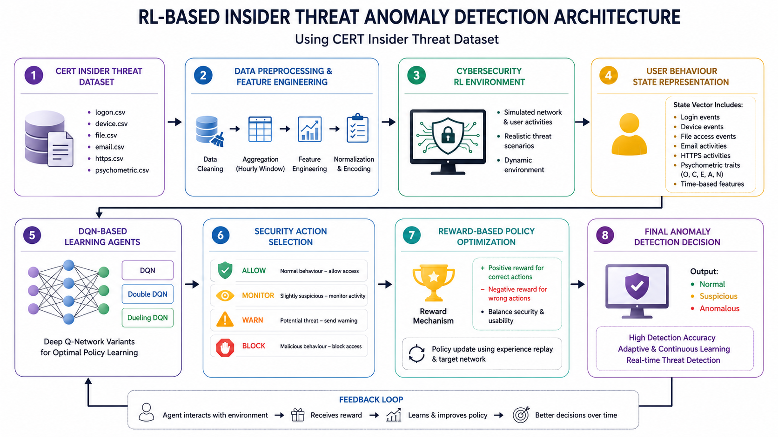
PROJECT ARCHITECTURE

Slide 6
DATASET DESCRIPTION
Dataset Overview
  Organizational Insider Threat Behaviour Data
  User Activity Logs For Security Analysis
  Behavior Patterns Used As RL States
RAW Data Files
  Logon Authentication Activity Records
  External Device Usage Events
  File Access Operation History
  Email Communication Behaviour Logs
  HTTP Web Browsing Activities
  User Psychometric Personality Features

Slide 7
FEATURE ENGINEERING OF RAW DATA
Dataset Overview
  Organizational Insider Threat Behaviour Data
  User Activity Logs For Security Analysis
  Behavior Patterns Used As RL States
RAW Data Files
  Logon Authentication Activity Records
  External Device Usage Events
  File Access Operation History
  Email Communication Behaviour Logs
  HTTP Web Browsing Activities
  User Psychometric Personality Features

Slide 8
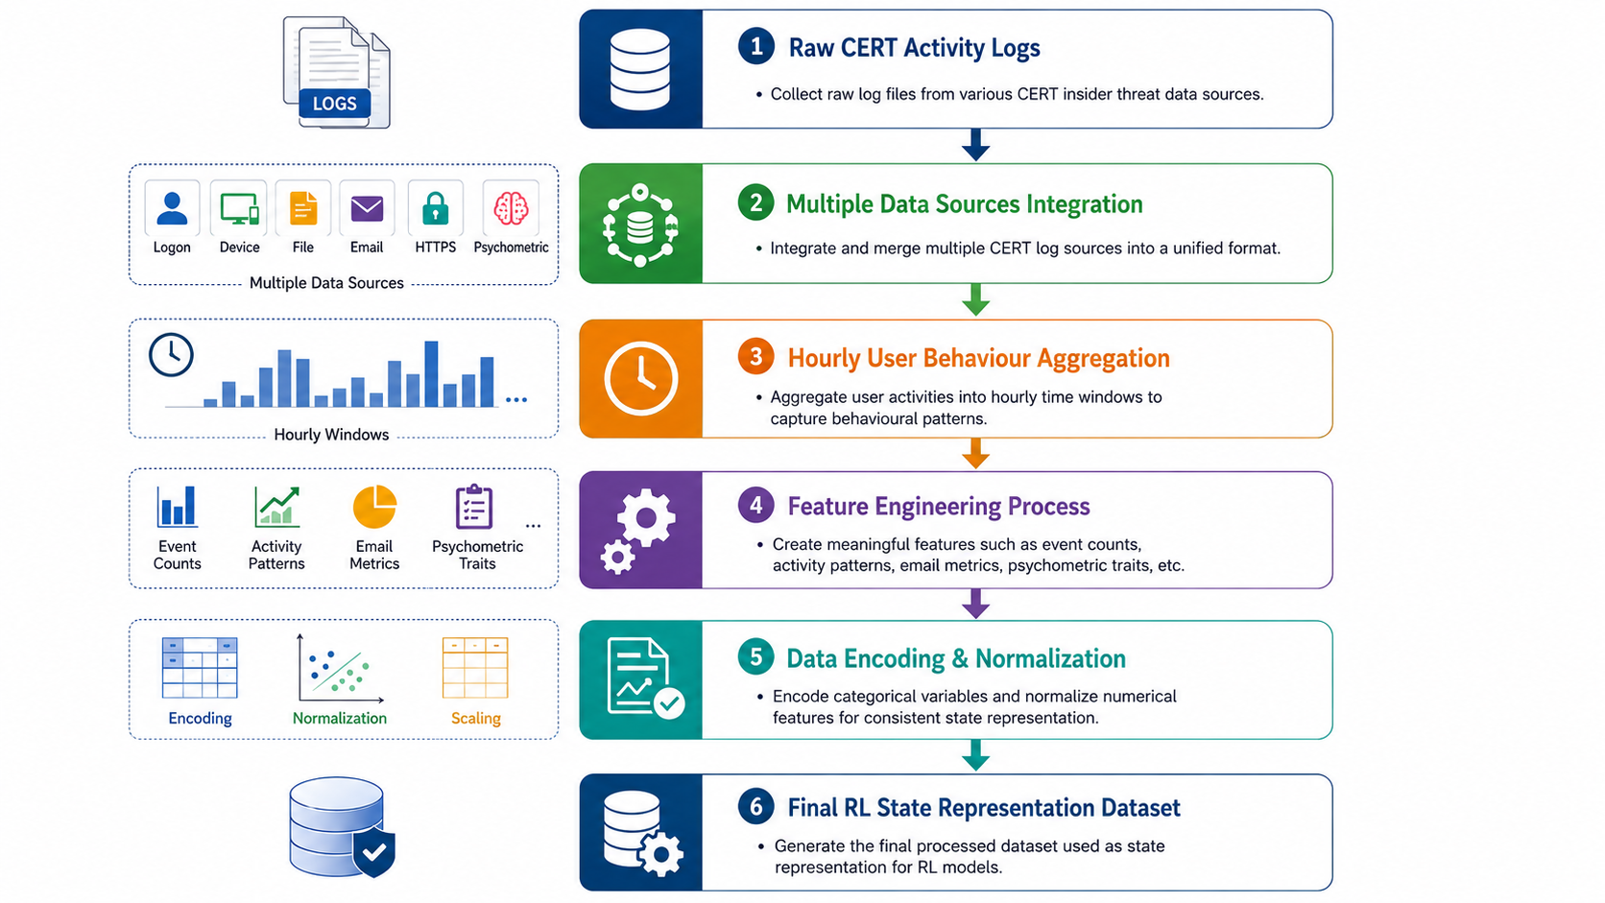
DATA PREPROCESSING PIPELINE

Slide 9
MODELLING
baseline
stability
best result
Deep Q-Network
Double DQN
Dueling DQN
DQN
Double Deep Q-Network
Dueling Deep Q-Network
A neural network approximates Q-values, replacing the Q-table for large state spaces. Uses experience replay and a target network.
Separates action selection from evaluation across online and target networks, reducing Q-value overestimation.
Splits the network into a value stream V(s) and an advantage stream A(s,a) for richer, more stable decisions.

Slide 10
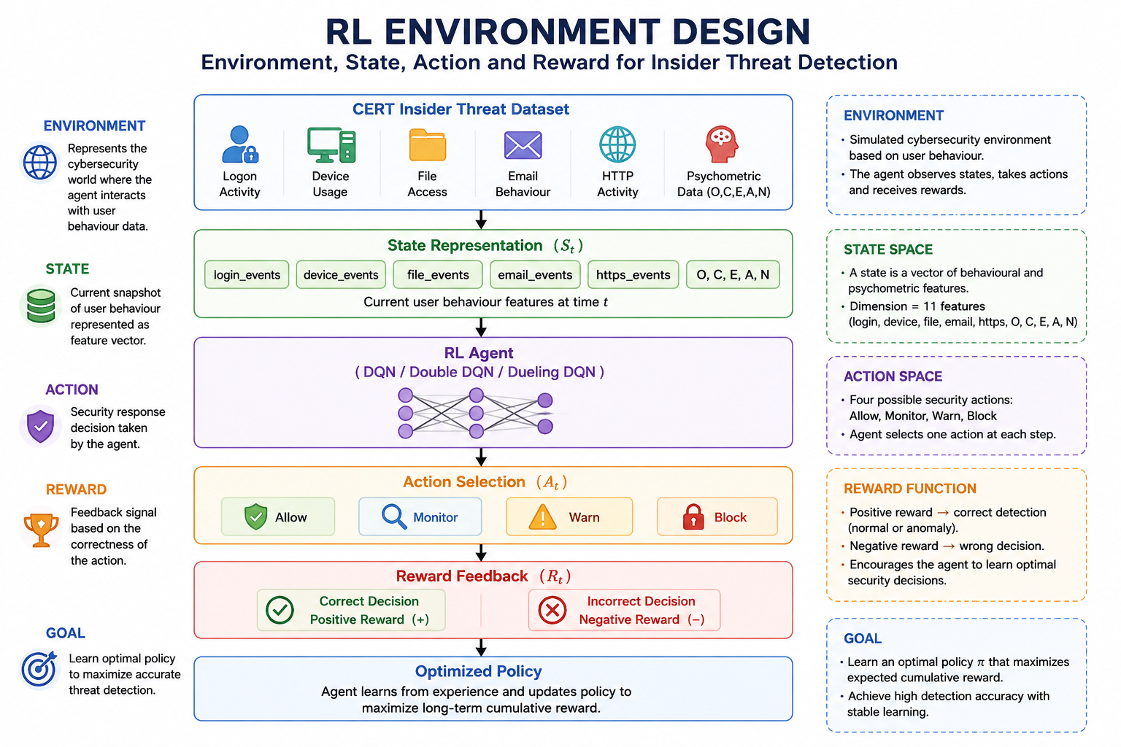
ENVIRONEMNT, STATE, ACTION, & REWARD

Slide 11
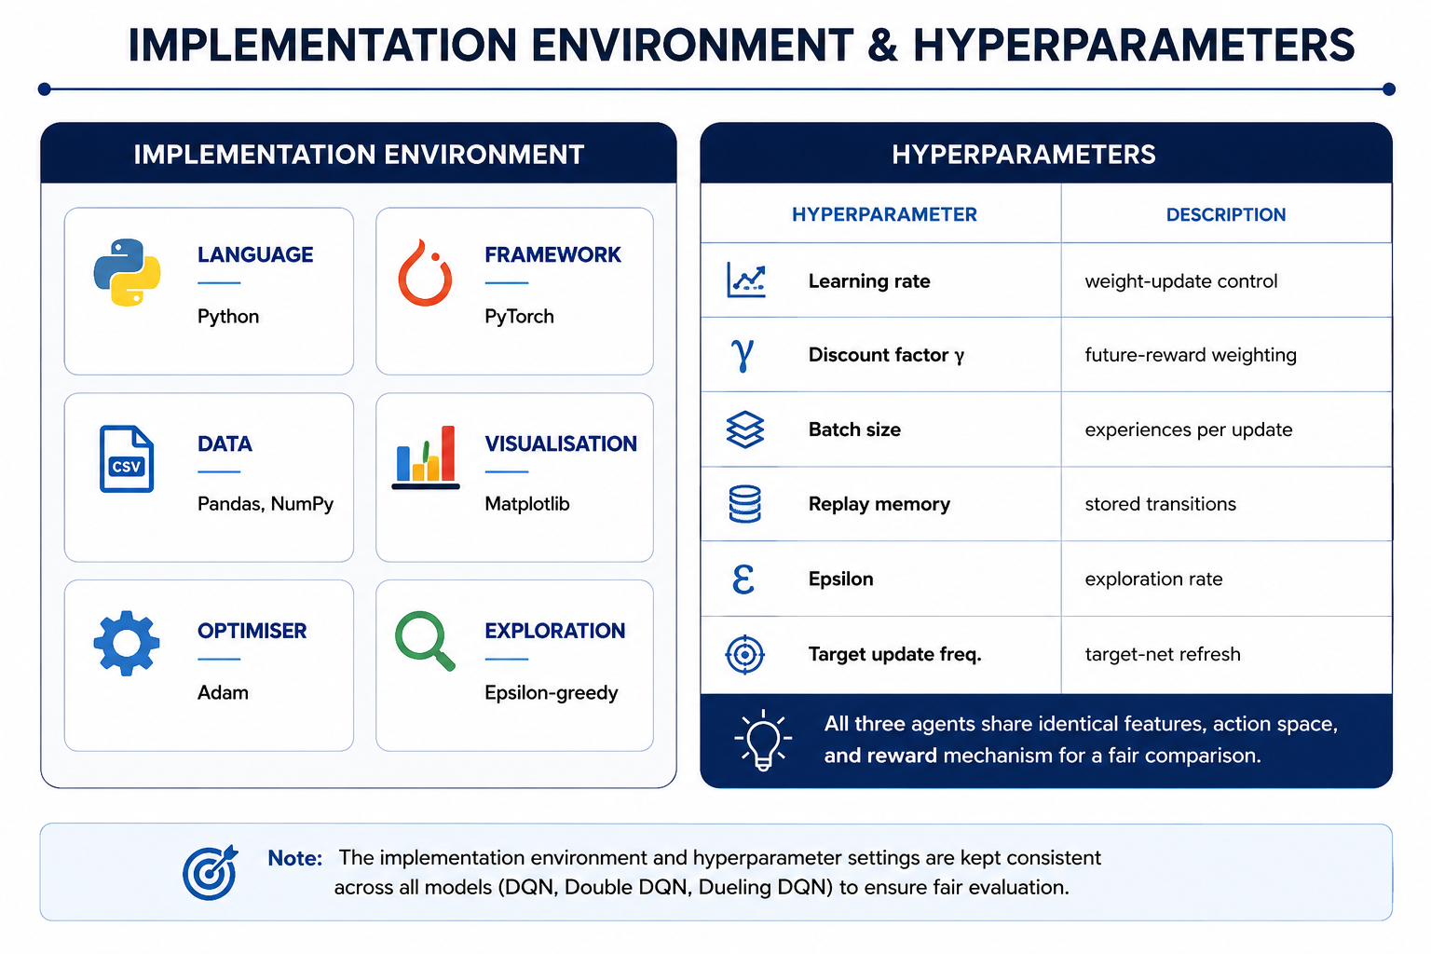
EXPERIMENTAL SETUP

Slide 12
HYPERPARAMETERS
Hyperparameter | Value
Episodes | 25
Sample Size Per Episode | 100,000 records
Batch Size | 64
Learning Rate | 0.001
Discount Factor (Gamma γ) | 0.95
Replay Memory Size | 50,000
Initial Exploration (ε) | 1.0
Minimum Epsilon | 0.01
Epsilon Decay | 0.99998
Target Network Update | Every 5 Episodes
Replay Frequency | Every 4 Steps
Optimizer | Adam
Loss Function | Mean Squared Error (MSE)

Slide 13
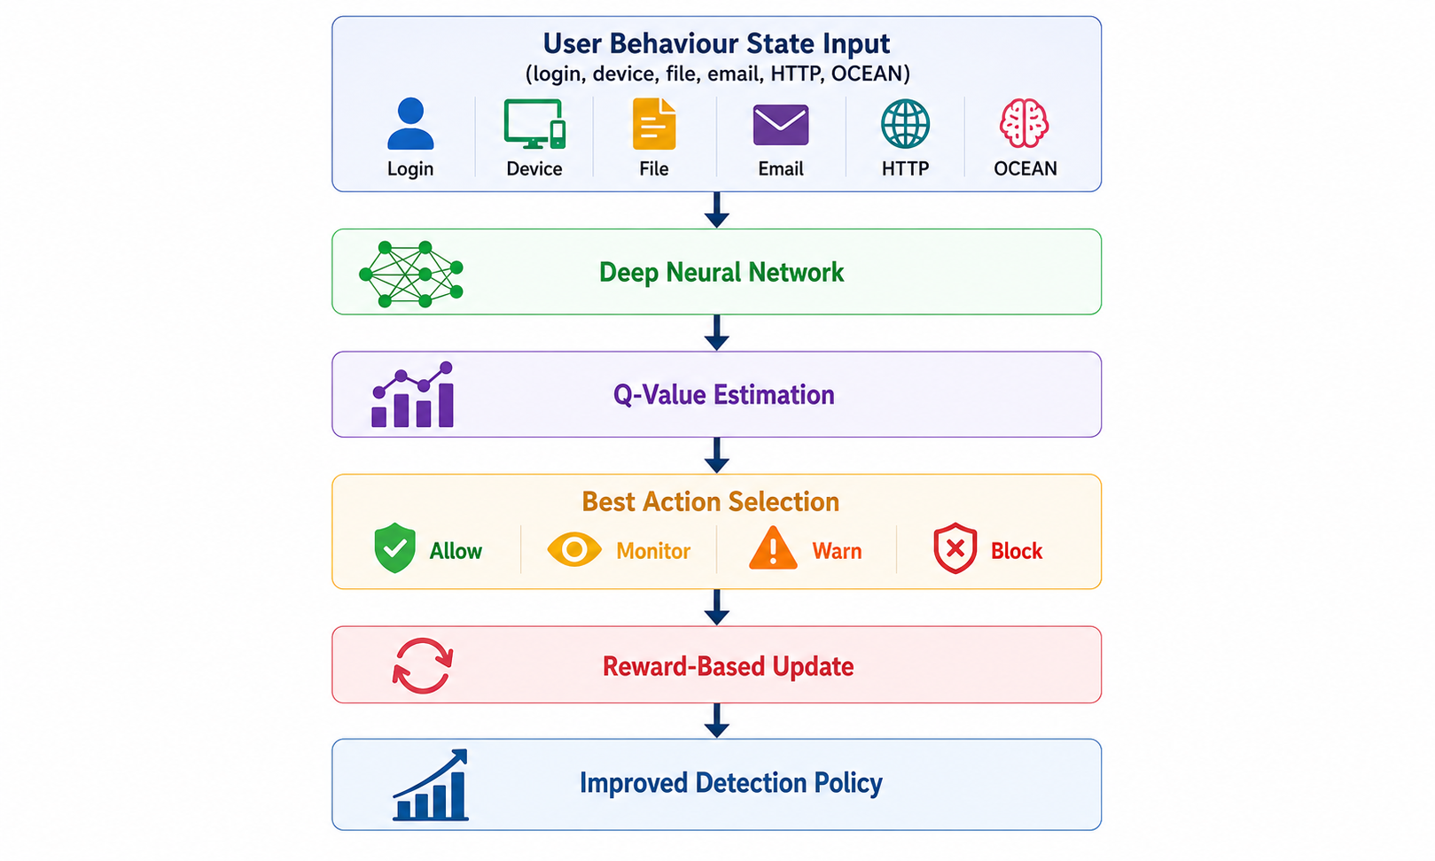
DQN MODEL
Overview
  Combines Q-Learning With Deep Neural Networks
  Learns Optimal Security Actions From User States
  Estimates Future Rewards Using Q-Values

Slide 14
CONTI
Why DQN Used?
  Handles Large Behaviour Feature Spaces
  Learns Without Fixed Detection Rules
  Improves Decisions Through Experience Replay
Key Components
  Experience Replay → Stable Training
  Target Network → Reliable Q-Learning
  Epsilon-Greedy → Exploration Strategy
  It takes user behaviour features as states and uses a neural network to predict Q-values for each security action. Based on reward feedback, the agent improves its policy to detect insider threats more accurately

Slide 15
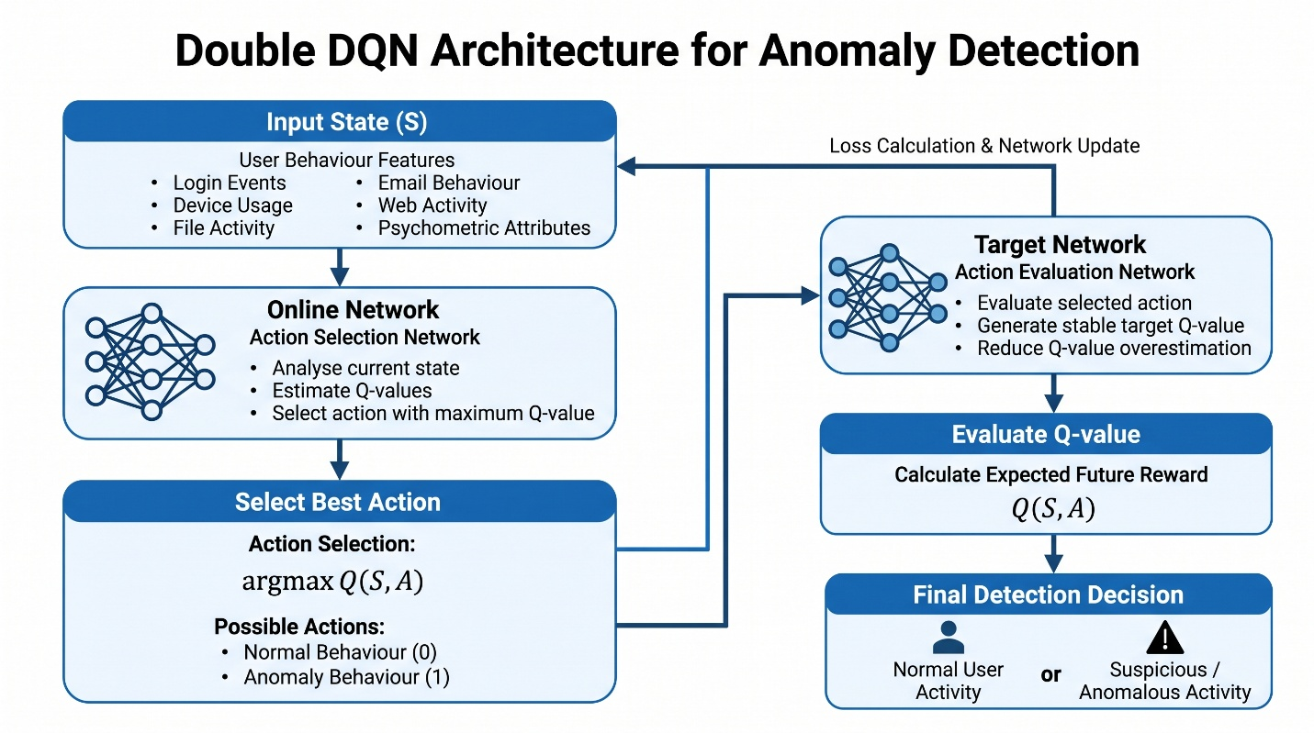
DOUBLE DQN MODEL
Overview
  Improved Version Of Standard DQN
  Separates Action Selection And Evaluation
  Provides More Stable Q-Value Learning
Why Double DQN Used?
  Reduces Q-Value Overestimation Problem
  Improves Learning Stability And Accuracy
  Produces More Reliable Security Decisions

Slide 16
CONTI
Key Advantage
  Better Q-Value Estimation
  Stable Training Performance
Double DQN improves standard DQN by using two networks. The online network selects the action, while the target network evaluates it. This reduces overestimated Q-values and creates more stable anomaly detection decisions.

Slide 17
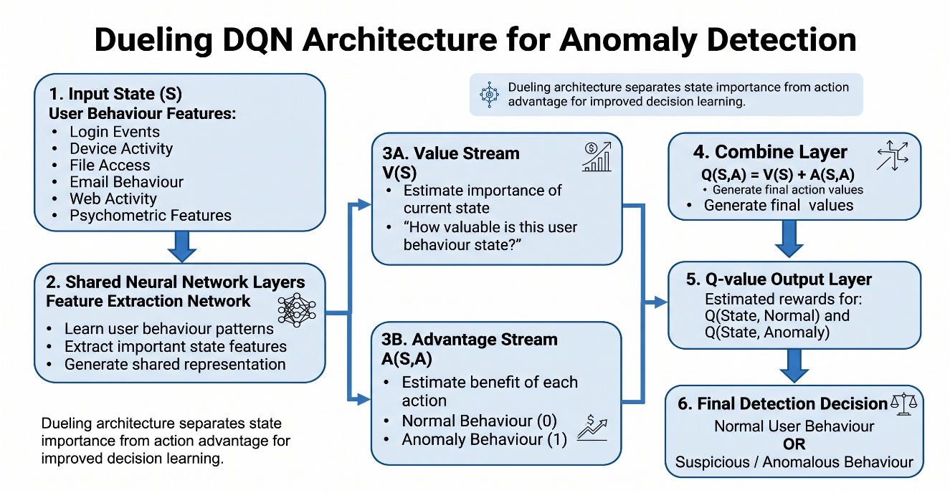
DUELLING DQN MODEL
Overview
  Advanced DQN Architecture Design
  Separates State And Action Learning
  Learns Importance Of Each Situation
Why Dueling DQN Used?
  Understands Critical User Behavior States
  Improves Decision-Making Quality
  Provides Efficient Policy Learning

Slide 18
CONTI
Key Advantage
  Learns State Importance Separately
  More Effective Threat Decisions
Dueling DQN divides learning into two streams. The value stream learns how important the current user state is, while the advantage stream learns which security action is better. Both combine to produce final Q-values.

Slide 19
RESULTS & EVALUATIONS
Metric | DQN | Double DQN | Dueling DQN
Accuracy | 99.93% | 99.90% | 99.98%
Precision | 99.93% | 99.91% | 99.98%
Recall | 99.93% | 99.90% | 99.98%
F1 Score | 99.93% | 99.91% | 99.98%
Test Reward | 43,910,090 | 43,903,200 | 43,923,560
Final Training Reward | 13,366,78 | 13,368,295 | 13,375,915
Average Loss | 225.89 | 202.99 | 189.77

Slide 20
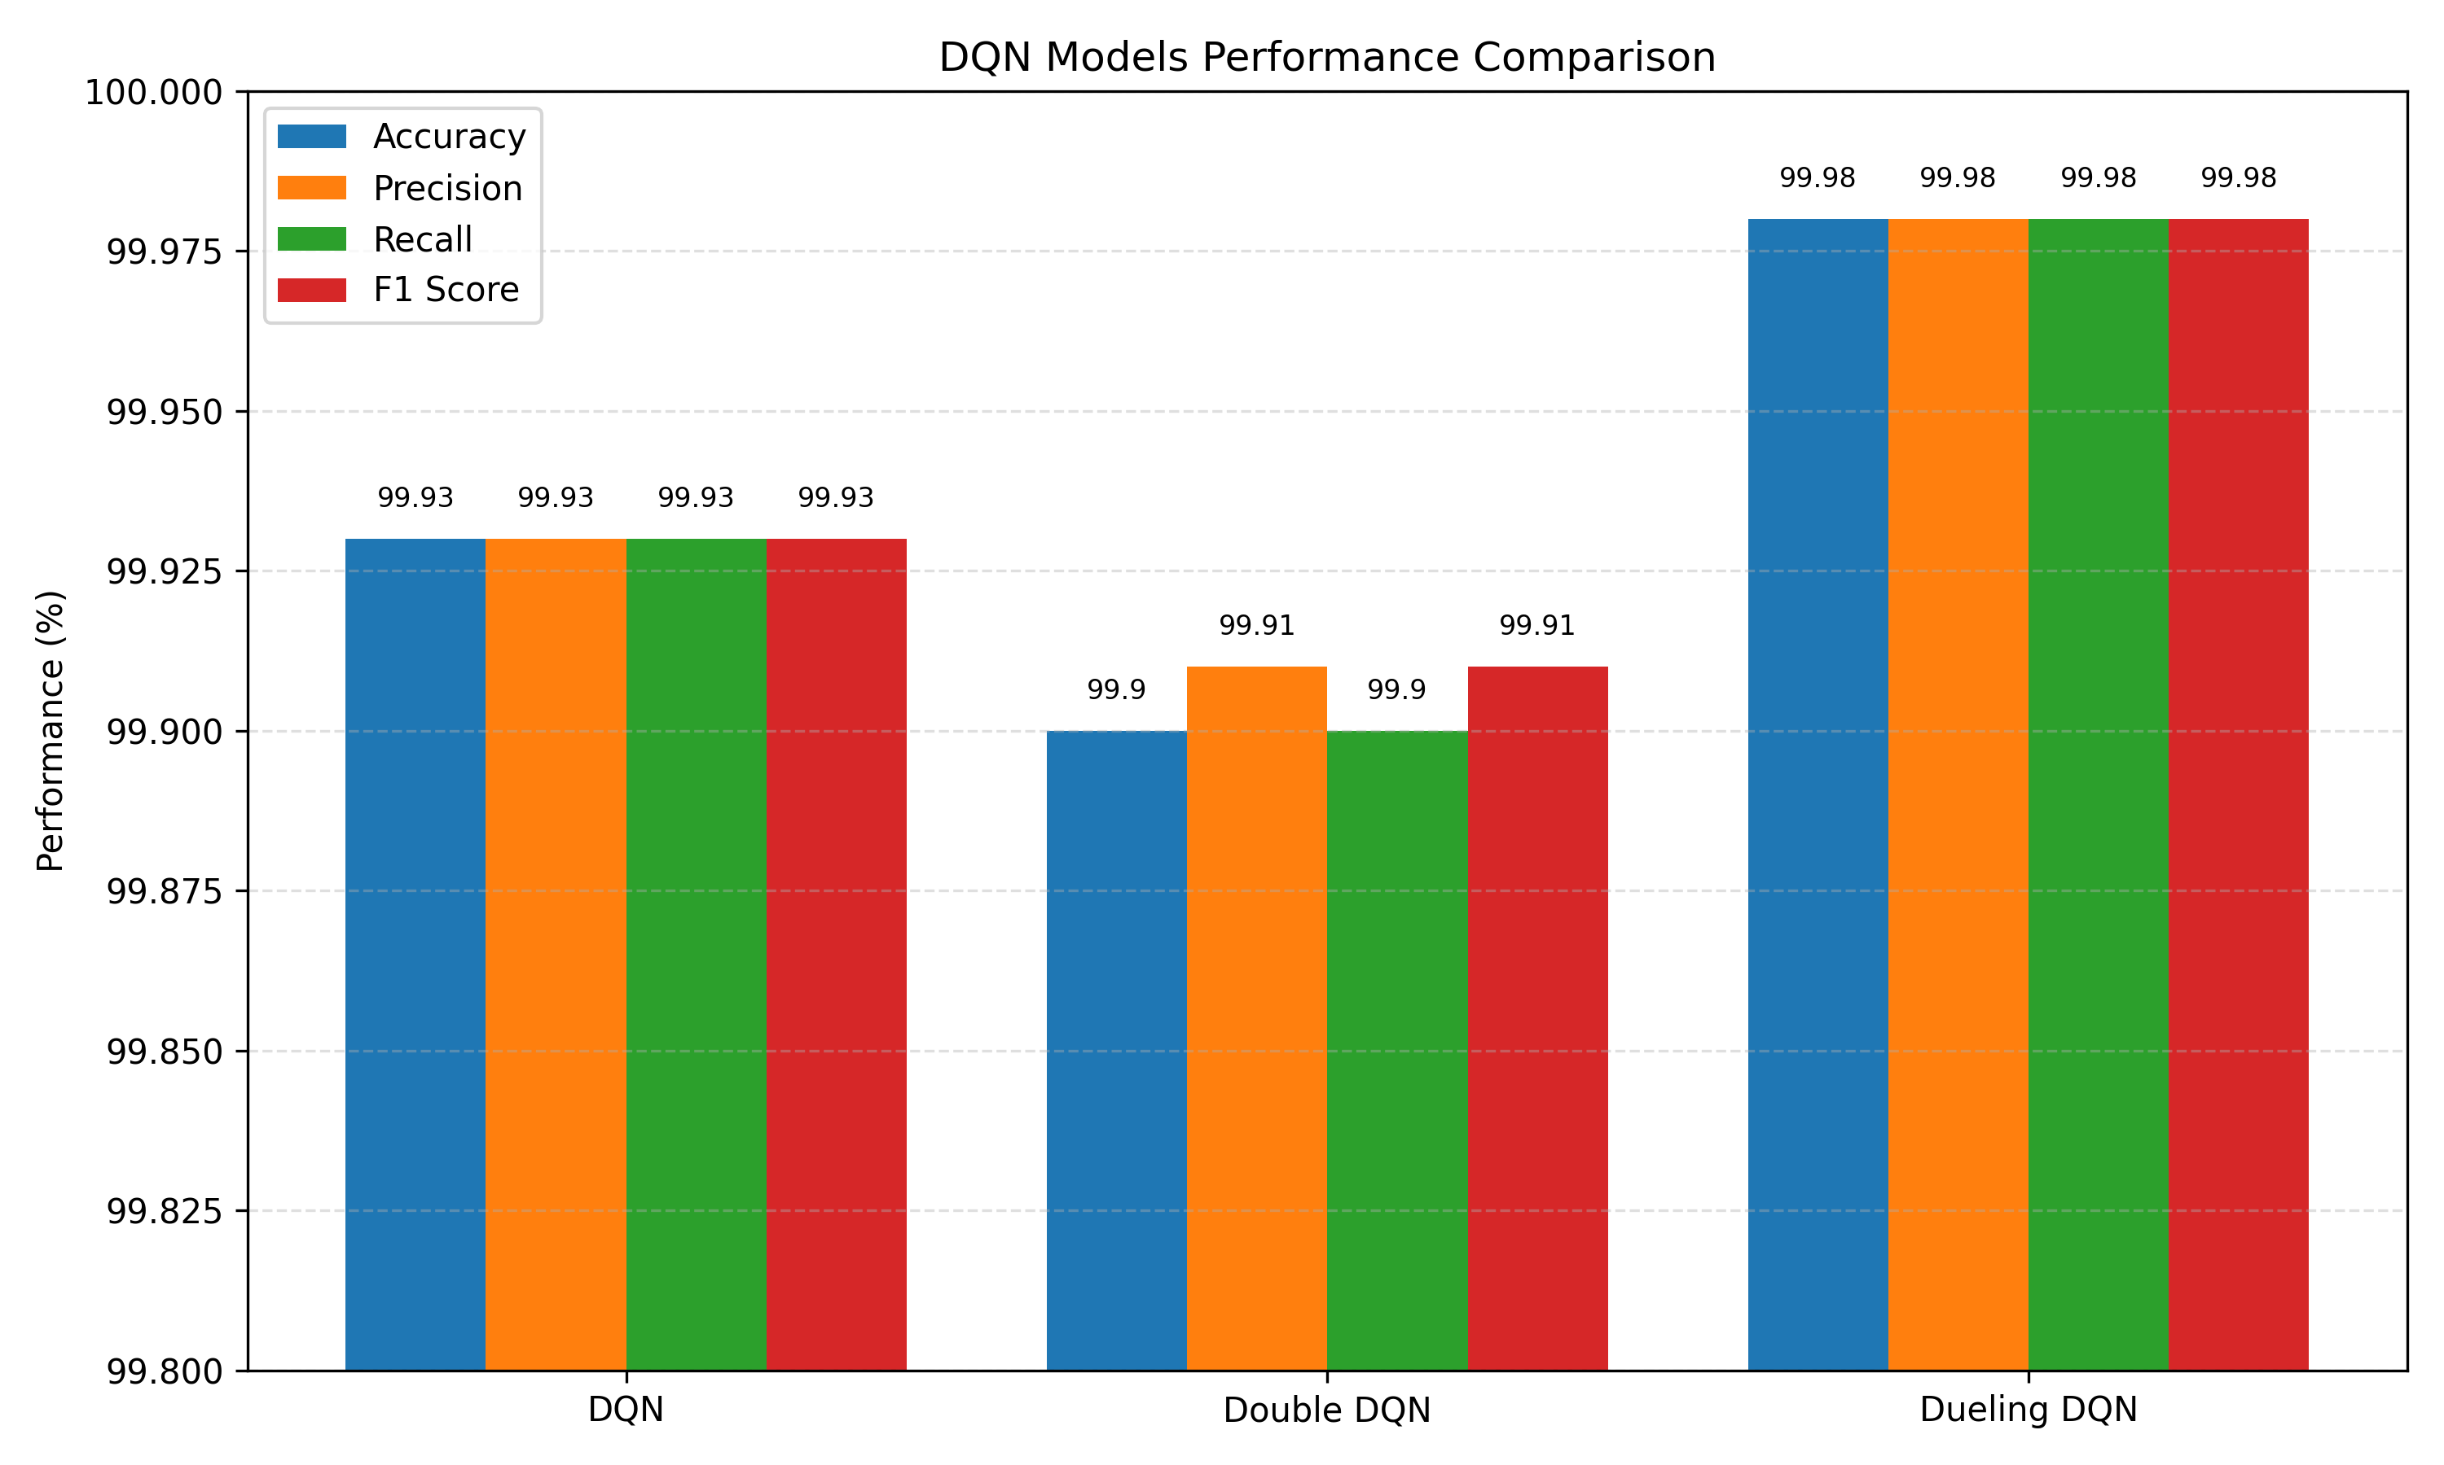
CONT.

Slide 21
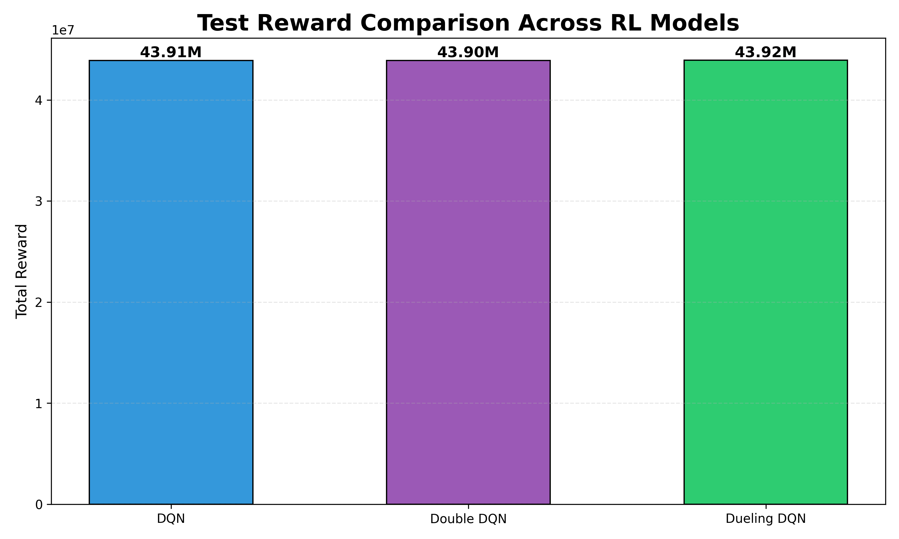
CONTI.

Slide 22
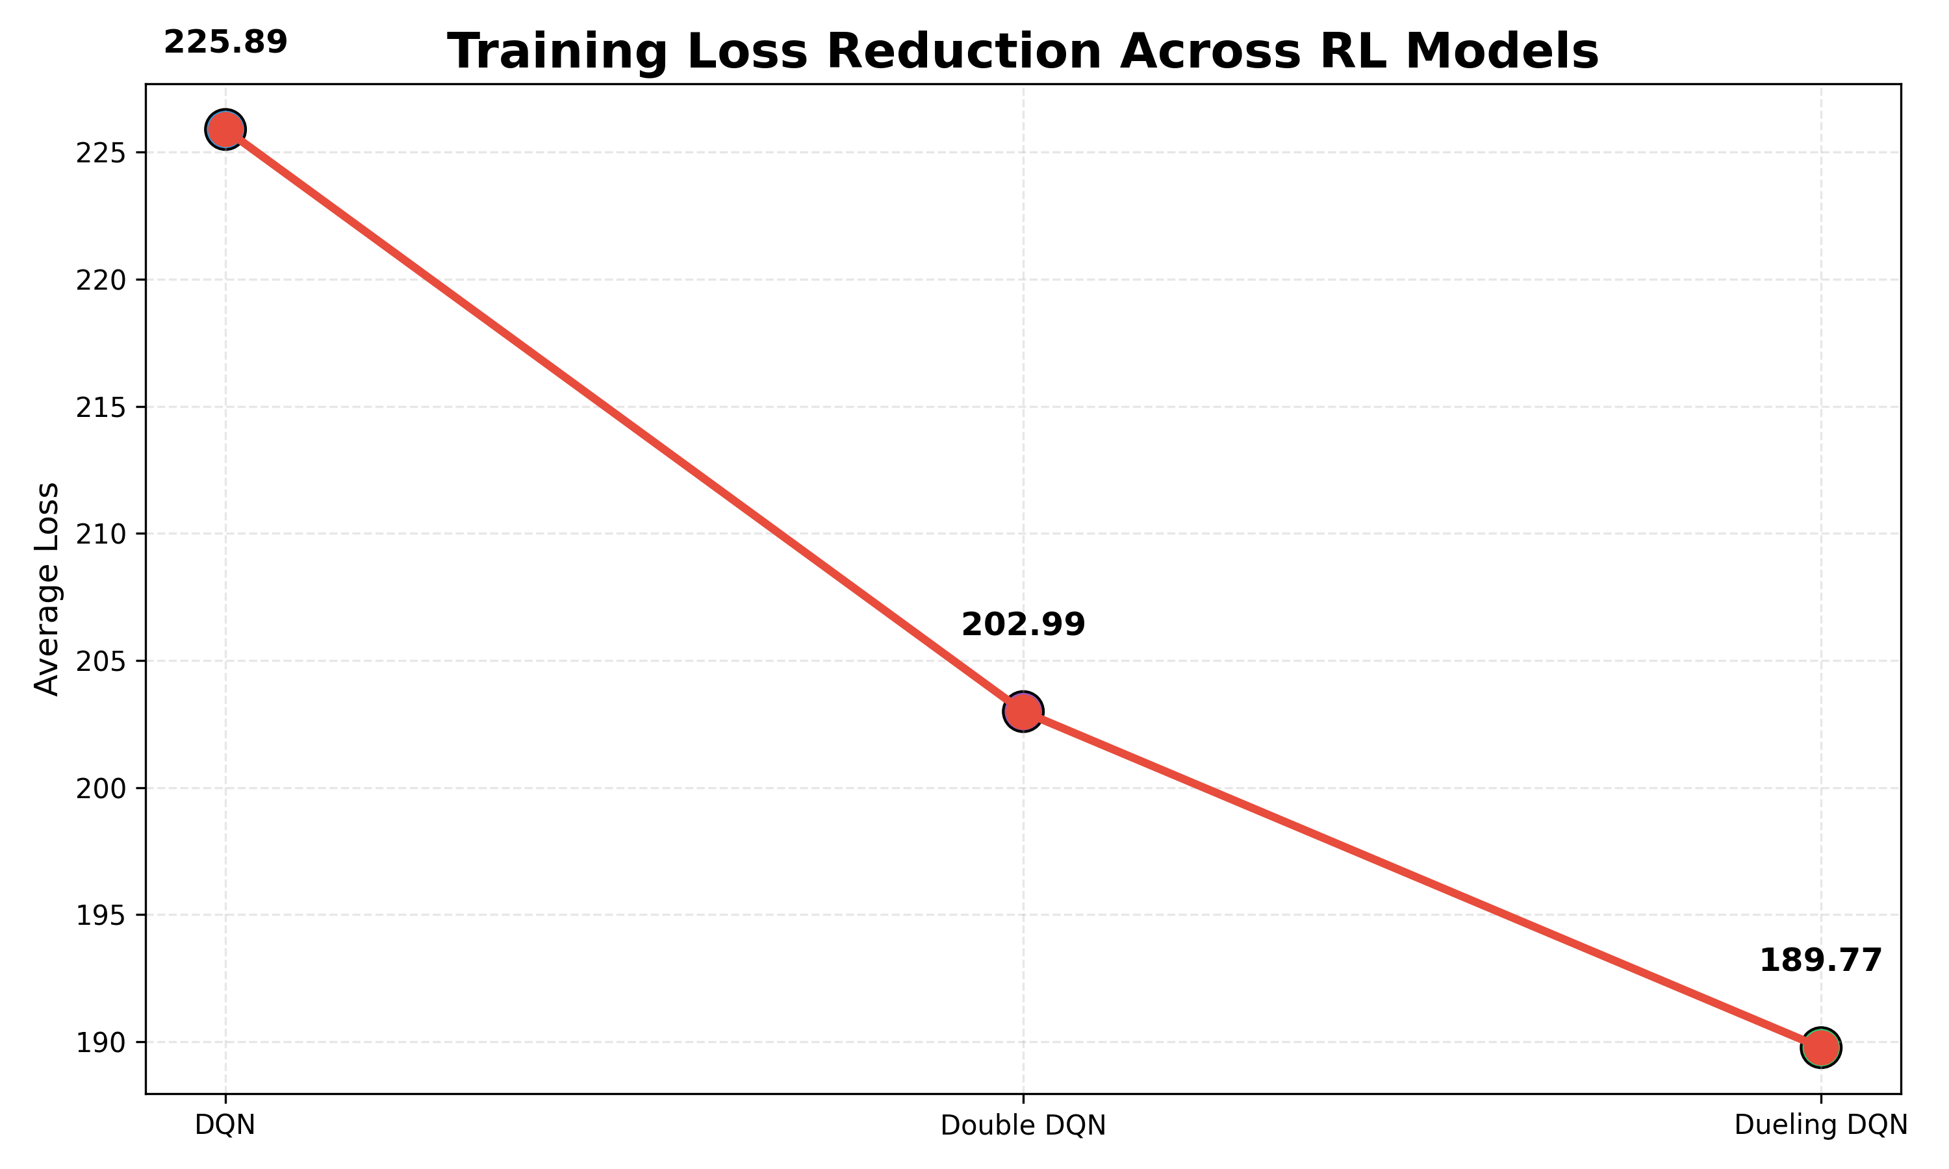
CONT....

Slide 23
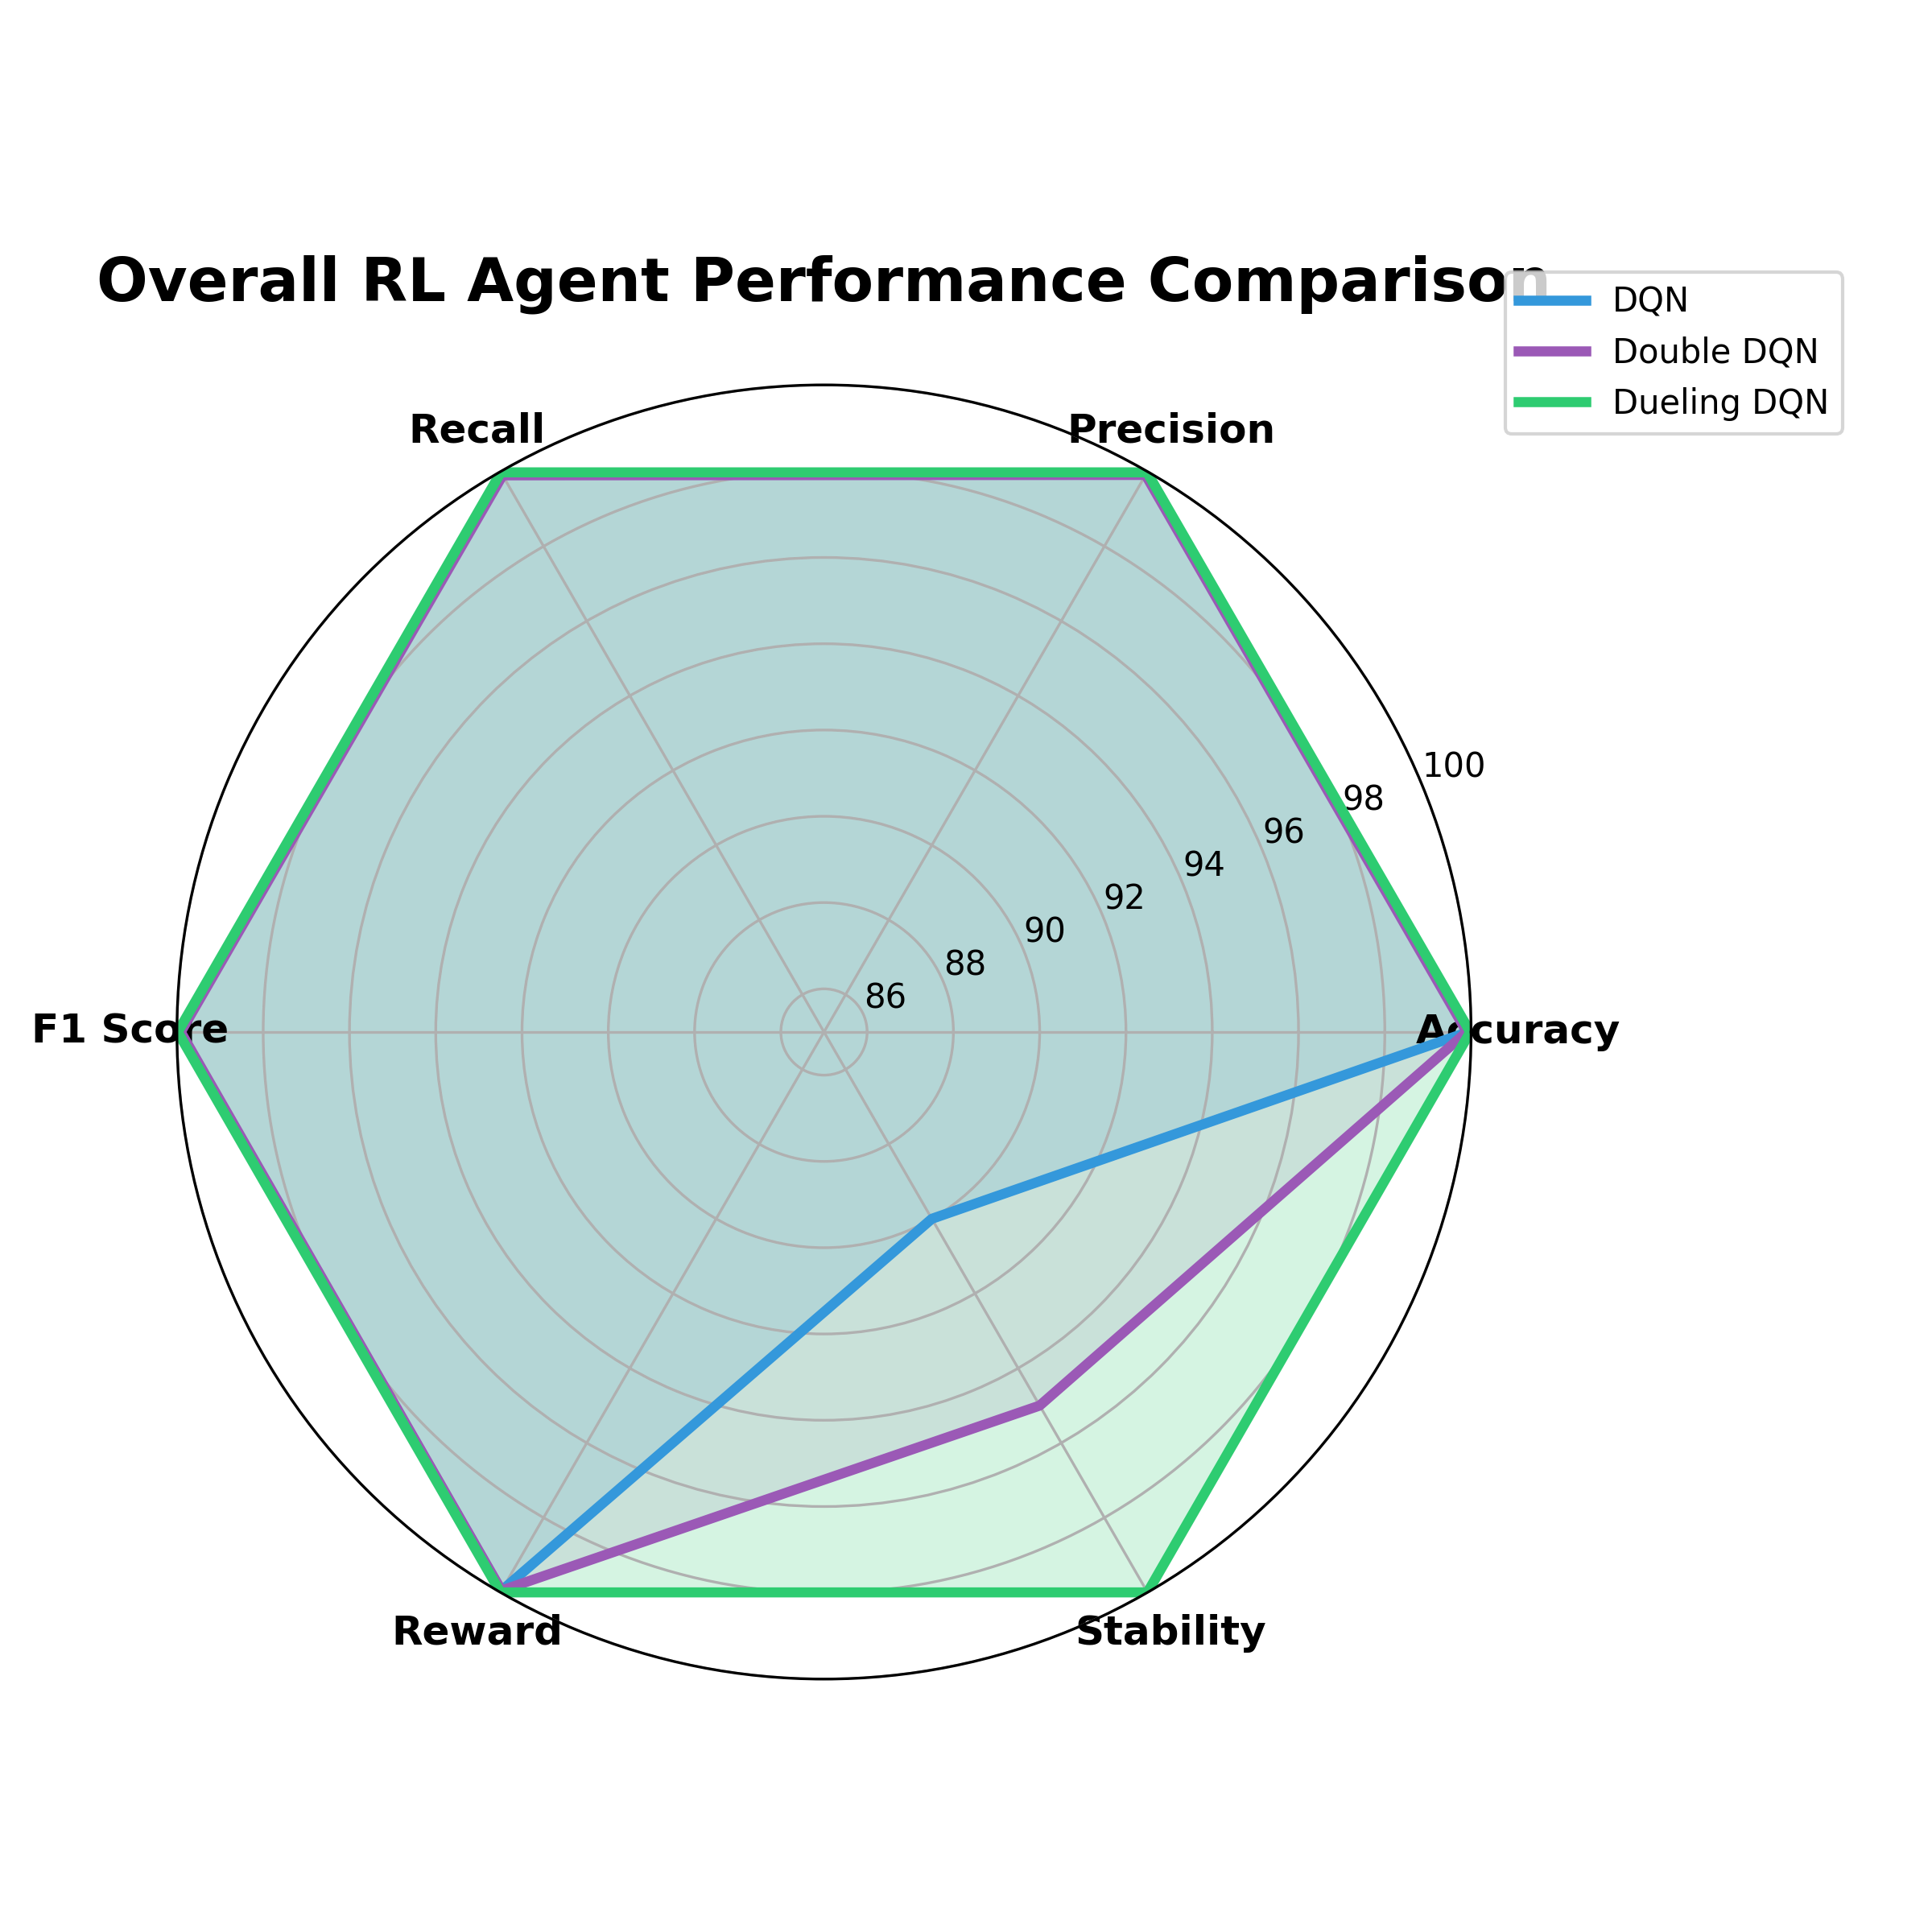
CONT..

Slide 24
CONTI.
Evaluation Metric | DQN | Double DQN | Dueling DQN
Detection Accuracy | Good | Improved | Highest
Cumulative Reward | Stable Increase | Higher Reward Gain | Best Reward Optimization
Training Loss | More Fluctuation | More Stable | Smooth Convergence
Q-Value Learning | Overestimation Issue | Reduced Bias | Better State Evaluation
Learning Stability | Moderate | High | Highest
Decision Quality | Baseline Decisions | Reliable Decisions | Optimized Decisions
Convergence Speed | Normal | Faster | Fastest

Slide 25
KEY FINDINGS
DQN: Successfully learned basic anomaly detection policy
Double DQN: Improved stability by reducing Q-value overestimation
Dueling DQN: Achieved better decisions through state-value separation

Slide 26
QUESTION
ANSWER

Slide 27
THANK YOU

